Slide 1
INFLUENCE OF SYSTEMIC CONDITIONS
ON THE PERIODONTIUM
Dr. Hema Duddukuri

Slide 2


Pathogenesis of Periodontitis
Environmental and acquired risk factors
Host Immuno- inflammatory response
Connective tissue and bone metabolism
Clinical signs of disease initiation and progression
Microbial
Challenge
Genetic risk factors
Page, Ann Periodontol 1998

Slide 3
Many systemic diseases, disorders, and conditions have been implicated as risk indicators or risk factors in periodontal disease.
How?
  They alter host tissues and physiology,
  which may impair the host’s barrier function and immune defense against periodontal pathogens,
  thereby creating the opportunity for destructive periodontal disease to progress.
The systemic diseases, disorders, or conditions themselves do not cause periodontitis; rather, they may predispose, accelerate, or otherwise increase the disease’s progression.

Slide 4
Endocrine Disorders and Hormonal Changes
Hematologic Disorders and Immune Deficiencies
Genetic Disorders
Stress and Psychosomatic Disorders
Nutritional Influences
Medications
Other Systemic Conditions

Slide 5
Endocrine Disorders and Hormonal Changes
Endocrine diseases → diabetes and
hormonal fluctuations →puberty and pregnancy are well-known examples of systemic conditions that adversely affect the condition of the periodontium.
  They affect the periodontal tissues directly,
  modify the tissue response to local factors, and
  produce anatomic changes in the gingiva that may favor plaque accumulation and disease progression.

Slide 6
Diabetes mellitus
complex metabolic disorder characterized by chronic hyperglycemia→ high blood glucose levels and the excretion of sugar in the urine.
Types: I & II
Uncontrolled diabetes (chronic hyperglycemia) is associated with several long-term complications:
  microvascular diseases (retinopathy, nephropathy, or neuropathy),
  macrovascular diseases (cardiovascular and cerebrovascular conditions),
  increased susceptibility to infections, and
  poor wound healing.

Slide 7
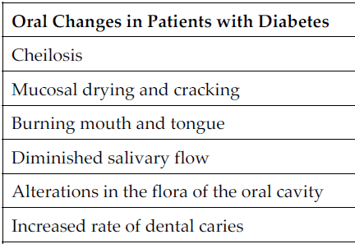

Slide 8
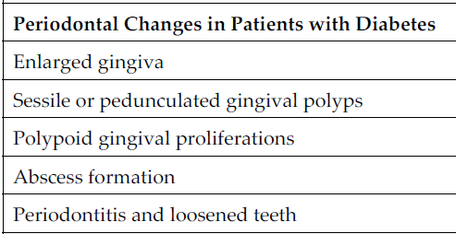
PERIODONTITIS IS THE 6TH COMPLICATION OF DIABETES.
Severe gingival inflammation, deep periodontal pockets, rapid bone loss, and frequent periodontal abscesses
Children: 1st molars,incisors
Adults: generalized
Rate of destruction increases with age

Slide 9
HOW DIABETES INFLUENCES PERIODONTIUM?
It does not cause gingivitis or periodontitis, but alters the response of the periodontal tissues to local factors, thereby hastening bone loss and delaying postsurgical healing.
Mainly by 3 mechanisms:
  Bacterial pathogens
  PMN function
  Altered collagen metabolism

Slide 10
  Bacterial pathogens:
Increased glucose levels in blood and GCF→ favors growth of pathogenic bacteria.
Type 1 diabetes mellitus and periodontitis: mainly of Capnocytophaga, anaerobic vibrios, and Actinomyces species.
Type 2 diabetes with severe periodontal lesions: Black-pigmented species—especially P. gingivalis, P. intermedia, and C. rectus—are prominent.

Slide 11
  Polymorphonuclear leukocyte function:
In patients with poorly controlled diabetes, functions of PMNs, monocytes, and macrophages are impaired.
impaired chemotaxis, defective phagocytosis, or impaired adherence.
primary defense mounted by PMNs against periodontal pathogens is diminished, and bacterial proliferation is more likely.
increased susceptibility of patients with diabetes to infection

Slide 12
  Altered collagen metabolism:
Chronic hyperglycemia impairs collagen structure and function→ affects the synthesis, maturation, and maintenance of collagen and extracellular matrix→ impact the integrity of the periodontium
In hyperglycemic state: nonenzymatic glycosylation of proteins & matrix molecules→ forms AGEs=Accumulated Glycation End-Products
Excessive AGEs formed in DM→ croslink to collagen→ makes collagen less soluble→ less likely to be repaired/replaced
More older and weak collagen present in tissues→ makes its susceptible to pathogenic breakdown

Slide 13
Metabolic syndrome
a condition of abdominal obesity combined with two or more of the following metabolic disturbances:
  hypertension,
  dyslipidemia, and
  Hyperglycemia
The association between periodontitis and metabolic syndrome is thought to be the result of systemic oxidative stress and an increased inflammatory response.
Obesity is associated with increased cytokine production as well as T-cell and monocyte/macrophage dysfunction, factors known to contribute to periodontitis

Slide 14
Female sex hormones
Physiologic hormonal changes in the female patient→ Gingival alterations during:
  puberty
  pregnancy
  Menopause
  Use of hormonal contraceptives
  Menopause

Slide 15
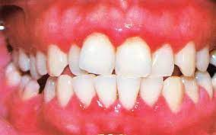
Puberty:
Puberty gingivitis
Seen in adolescents & diminishes with age
is often accompanied by an exaggerated response of the gingiva to plaque due to hormonal changes
However, complete return to normal health requires the removal of these factors.
With good oral hygiene, it can be prevented.

Slide 16
Menstruation:
During the menstrual period, the prevalence of gingivitis increases.
bleeding gums or a bloated, tense feeling in the gums during the days preceding menstrual flow.
The exudate from inflamed gingiva is increased during menstruation, which suggests that preexisting gingivitis is aggravated by menstruation;
however, the crevicular fluid of normal, healthy gingiva is unaffected.
Tooth mobility does not change significantly during the menstrual cycle.
The salivary bacterial count is increased during menstruation and at ovulation, which occurs up to 14 days earlier.

Slide 17
Pregnancy
Pregnancy gingivitis: pregnancy itself does not cause it.
Gingivitis during pregnancy is caused by bacterial plaque & The hormonal changes of pregnancy accentuate the gingival response to plaque and modify the resultant clinical picture.
No notable changes occur in the gingiva during pregnancy in the absence of local factors
Tooth mobility, pocket depth, and gingival fluid are also increased during pregnancy
The severity of gingivitis is increased during pregnancy beginning in the second or third month. Gingivitis becomes more severe by the eighth month and decreases during the ninth month of pregnancy
Partial reduction in the severity of gingivitis occurs by 2 months postpartum, and after 1 year, the condition of the gingiva is comparable to that of patients who have not been pregnant.

Slide 18
Pronounced ease of bleeding is the most striking clinical feature.
The gingiva is inflamed and varies in color from bright red to bluish red.
The marginal and interdental gingivae are edematous; they pit on pressure, appear smooth and shiny, are soft and pliable, and sometimes have a raspberry-like appearance.
The extreme redness results from marked vascularity, and there is an increased tendency to bleed.
The gingival changes are usually painless unless they are complicated by acute infection.

Slide 19
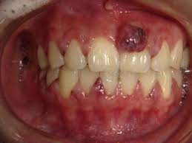
Pregnancy tumor:
In some cases, the inflamed gingiva forms discrete tumor-like masses, which are referred to as pregnancy tumors.
Microscopically, gingival disease during pregnancy appears as nonspecific, vascularizing, and proliferative inflammation→ angiogranuloma

Slide 20
Mechanisms:
P. intermedia appears to be the only microorganism that increases significantly during pregnancy.
This increase appears to be associated with elevations in systemic levels of estradiol and progesterone and to coincide with the peak in gingival bleeding due to their effect on vasculature
The destruction of gingival mast cells by the increased sex hormones and
the resultant release of histamine and proteolytic enzymes may also contribute to the exaggerated inflammatory response to local factors.

Slide 21
Hormonal contraceptives:
aggravate the gingival response to local factors in a manner similar to that seen during pregnancy;
when these drugs are taken for longer than 1.5 years, there is an increase in periodontal destruction.

Slide 22
Menopause:
the usual rhythmic hormonal fluctuations of the female cycle are ended as estradiol ceases to be the major circulating estrogen.
As a result, women can develop a Menopausal gingivostomatitis. not a common condition.
The gingiva and the remaining oral mucosa are dry and shiny, they vary in color from abnormal paleness to redness, and they bleed easily.
The patient complains of a dry, burning sensation throughout the oral cavity that is associated with extreme sensitivity to thermal changes; abnormal taste sensations described as “salty,” “peppery,” or “sour”; and difficulty with removable partial prostheses.
The signs and symptoms of menopausal gingivostomatitis are somewhat comparable to those of chronic desquamative gingivitis
Signs and symptoms similar to those of menopausal gingivostomatitis occasionally occur after ovariectomy or sterilization by radiation in the treatment of malignant neoplasms.

Slide 23
Hyperparathyroidism
Parathyroid hypersecretion produces generalized demineralization of the skeleton, increased osteoclasis with proliferation of the connective tissue in the enlarged marrow spaces, and the formation of bone cysts and giant cell tumors.
The disease is called osteitis fibrosa cystica or von Recklinghausen bone disease
Loss of the lamina dura and giant cell tumors in the jaws are late signs of hyperparathyroid bone disease, which in itself is uncommon.

Slide 24
oral changes:
  malocclusion and tooth mobility,
  radiographic evidence of alveolar osteoporosis with closely meshed trabeculae,
  widening of the periodontal ligament space, absence of the lamina dura, and radiolucent cyst-like spaces.
Brown tumors:
Bone cysts become filled with fibrous tissue with abundant hemosiderin-laden macrophages and giant cells.
These cysts have been called brown tumors, but they are not tumors.
More accurately, they are reparative giant cell granulomas.
In some cases, these lesions appear in the periapical region of teeth, and they can lead to a misdiagnosis of a lesion of endodontic origin

Slide 25
HEMATOLOGIC DISORDERS AND IMMUNE DEFICIENCIES
All blood cells play an imp. role in maintaining a healthy periodontium.
  WBC: inflammatory and immune response
  RBC: gas and nutrient exchange
  Platelets: hemostasis
Disorders of any of these→ effect periodontium

Slide 26
Leukocyte (neutrophil) disorders
Disorders that affect the production or function of leukocytes may result in severe periodontal destruction.
  Neutropenia
  Agranulocytosis
  Leukemia

Slide 27
Neutropenia:
blood disorder that results in low levels of circulating neutrophils.
Mild neutropenia: An absolute neutrophil count (ANC) of 1000–1500 cells/μL
Moderate: 500–1000 cells/μL is considered moderate neutropenia and an ANC of
Severe: <500 cells/μL→ fatal
It may be chronic or periodic, with recurring neutropenic cycles→ cyclic neutropenia.
With cyclic neutropenia, the gingival changes recur with recurrent exacerbation of the disease.
The occurrence of generalized aggressive periodontitis has been described in patients with cyclic neutropenia

Slide 28
Agranulocytosis:
reduction in the number of circulating granulocytes, and it results in severe infections
It is defined as an ANC of <100 cells/μL.
results in severe infections, including ulcerative necrotizing lesions
The absence of a notable inflammatory reaction caused by a lack of granulocytes is a striking feature.
The gingival margin may or may not be involved.
Gingival hemorrhage, necrosis, increased salivation, and fetid odor are accompanying clinical features.

Slide 29
Leukemias:
are malignant neoplasias of WBC precursors
leukemias are classified as:
      Lymphocytic→ involves precursors of lymphocytes
      Myelogenous→ involves precursors of rbc, wbc & platelets
According to their evolution, leukemias can be:
      acute (which is rapidly fatal),
      subacute, or
      chronic.
All leukemias tend to displace normal components of the bone marrow elements with leukemic cells, → reduced production of normal RBCs, WBCs, and platelets, → anemia, leukopenia (a reduction in the number of nonmalignant WBCs), and thrombocytopenia
Aleukemic leukemia: Some patients may have normal blood counts while leukemic cells reside primarily in the bone marrow.

Slide 30
The periodontium in leukemic patients
Leukemic gingival enlargement→ due to leukemic cell infiltration,
seen mostly in AMoL> Amy-MoL> AMyL. Not seen in chronic.
localized to the interdental papilla or it may expand to include the marginal gingiva and partially cover the crowns of the teeth
gingiva appears bluish red and cyanotic, with a rounding and tenseness of the gingival margin.
leukemia cutis: abnormal accumulation of leukemic cells in the dermal and subcutaneous connective tissue, and it forms elevated and flat macules and papules
Gingival bleeding & oral ulceration and infection

Slide 31
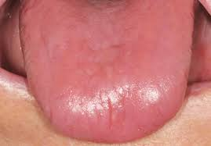
Anemia
Pernicious anemia results in tongue changes in 75% of patients. The tongue appears red, smooth, and shiny as a result of atrophy of the papillae. There is also marked pallor of the gingiva
Iron deficiency anemia induces similar tongue and gingival changes.
Plummer–Vinson syndrome: glossitis and ulceration of the oral mucosa and oropharynx and that induces dysphagia in patients with iron deficiency anemia

Slide 32
Sickle cell anemia is a hereditary form of chronic hemolytic anemia. Oral changes include generalized osteoporosis of the jaws, with a peculiar stepladder alignment of the trabeculae of the interdental septa, along with pallor and yellowish discoloration of the oral mucosa. Periodontal infections may precipitate sickle cell crisis.
Aplastic anemia results from a failure of the bone marrow to produce erythrocytes. The etiology is usually the effect of toxic drugs on the marrow or the displacement of RBCs by leukemic cells. Oral changes include pale discoloration of the oral mucosa and increased susceptibility to infection because of the concomitant neutropenia

Slide 33
Thrombocytopenia
reduced platelet count that results from either a lack of platelet production or an increased loss of platelets.
Purpura: purplish appearance of the skin or mucous membranes where bleeding has occurred as a result of decreased platelets.
The gingivae are swollen, soft, and friable.
Bleeding occurs spontaneously or with the slightest provocation, and it is difficult to control.
Gingival changes represent an abnormal response to local irritation.
The severity of the gingival condition is dramatically alleviated by removal of the local factors.

Slide 34
GENETIC DISORDERS
genetic disorders that result in an inadequate number or reduced function of circulating neutrophils→ Severe periodontitis:
  primary neutrophil disorders: neutropenia, agranulocytosis, Chédiak–Higashi syndrome, and lazy leukocyte syndrome.
  secondary neutrophil impairment: Down syndrome, Papillon–Lefèvre syndrome, and inflammatory bowel disease.

Slide 35
Chédiak–Higashi syndrome:
affects the production of organelles found in almost every cell. It affects mostly the melanocytes, platelets, and phagocytes.
It causes partial albinism, mild bleeding disorders, and recurrent bacterial infections.
Neutrophils contain abnormal, giant lysosomes that can fuse with the phagosome, but their ability to release their contents is impaired.
As a result, the killing of ingested microorganisms is delayed.→ susceptible to repeated infections that can be serious and life threatening.
Aggressive periodontitis has been described in these patients.

Slide 36
Lazy leukocyte syndrome:
susceptibility to severe microbial infections, neutropenia, defective chemotactic response by neutrophils, and an abnormal inflammatory response.
susceptible to aggressive periodontitis with destruction of bone and early tooth loss.

Slide 37
Leukocyte adhesion deficiency:
Inability to produce or express CD18/cell surface integrin, needed for leukocytes adherence to vessel wall at infection site.
Increased sus. To infections
Periodontal diseases: rare but begin after primary teeth erupts
Extremely acute inflammation and proliferation of the gingival tissues with rapid destruction of the bone are found.
Both the primary and the permanent teeth are affected, often resulting in early tooth loss.
also have frequent respiratory tract infections and sometimes otitis media

Slide 38
Papillon–lefèvre syndrome
Described by Papillon and Lefèvre in 1924
autosomal-recessive pattern: hyperkeratotic skin lesions, severe destruction of the periodontium, and, in some cases, calcification of the dura.
The cutaneous and periodontal changes usually appear between 2 - 4 years.
Skin lesions: hyperkeratosis and ichthyosis of palms, soles, knees, and elbows
Periodontal involvement: consists of early inflammatory changes that lead to bone loss and exfoliation of teeth.
The primary teeth are lost by 5 or 6 years of age. The permanent dentition erupts normally, but lost at a very early age (usually 15–20 years), patients are often edentulous except for the third molars.

Slide 39
Down syndrome
Trisomy 21
congenital disease caused by a chromosomal abnormality and is characterized by mental deficiency and growth retardation.
The prevalence of periodontal disease in patients with Down syndrome is high, occurring in almost 100% of patients who are younger than 30 years of age.
Although plaque, calculus, and local irritants (e.g., diastemata, crowding of teeth, high frenum attachments, malocclusion) are present and oral hygiene is poor, the severity of periodontal destruction exceeds that explainable by local factors alone

Slide 40
Periodontal disease in those with Down syndrome is characterized by the formation of deep periodontal pockets associated with substantial plaque accumulation and moderate gingivitis.
severe in the lower anterior region.
Moderate recession is sometimes seen in this region as well. The disease progresses rapidly.
The high prevalence and increased severity of periodontal destruction associated with Down syndrome is most likely explained by poor PMN chemotaxis, phagocytosis, and intracellular killing.

Slide 41
NUTRITIONAL INFLUENCES
Effects of nutrition on oral and periodontal tissues point to the following:
  There are no nutritional deficiencies that by themselves can cause gingivitis or periodontitis.
  However, they can affect the condition of the periodontium and thereby may accentuate the deleterious effects of plaque-induced inflammation in susceptible individuals.
  Theoretically, one may presume that an individual with a nutritional deficiency is less able to defend against a bacterial challenge as compared with a nutritionally competent individual
  There are nutritional deficiencies that produce changes in the oral cavity.
  These changes include alterations of the tissues of the lips, oral mucosa, gingiva, and bone.
  These alterations are considered to be the periodontal and oral manifestations of nutritional disease.

Slide 42
Fat-soluble vitamin deficiency
Vit A def.:
maintain the health of the epithelial cells of the skin and mucous membranes.
A deficiency→ degenerative changes in epithelial tissues,
Because epithelial tissues provide a primary barrier function to protect against invading microorganisms,
vitamin A may play an important role in protecting against microbial invasion by maintaining epithelial integrity.
studies have failed to demonstrate any relationship between this vitamin and periodontal disease in humans

Slide 43
Vitamin D or calciferol def.:
imbalance in calcium–phosphorus intake result in rickets in young children and osteomalacia in adults.
No studies have demonstrated a relationship between vitamin D deficiency and periodontal disease.
Vitamin E def.:
serves as an antioxidant to limit free-radical reactions and to protect cells from lipid peroxidation.
Cell membranes, which are high in polyunsaturated lipids, are the major site of damage in patients with vitamin E deficiency.
No relationship has been demonstrated between deficiencies in vitamin E and oral disease, but systemic vitamin E appears to accelerate gingival wound healing in the rat.

Slide 44
Water-soluble vitamin deficiency
B-complex deficiency:
Vitamin | Deficiency | Periodontal manifestations
B1: thiamin | beriberi | hypersensitivity of the oral mucosa; minute vesicles (simulating herpes) on the buccal mucosa, under the tongue, or on the palate; and erosion of the oral mucosa
B2: riboflavin | ariboflavinosis | Glossitis (magenta), angular cheilitis, seborrheic dermatitis, and a superficial vascularizing keratitis
B3: niacin | pellagra | dermatitis, gastrointestinal disturbances, neurologic and mental disturbances (dermatitis, diarrhea, or dementia), glossitis, gingivitis, and generalized stomatitis. gingiva may be involved in aniacinosis with or without tongue changes. necrotizing ulcerative gingivitis, usually in areas of local irritation
B9: folic acid |  | necrosis of the gingiva, the periodontal ligament, and the alveolar bone without inflammation→ animals Humans: ulcerated glossitis and cheilitis.

Slide 45
Vitamin C Deficiency-Scurvy
Characterized by hemorrahagic diathesis & delayed wound healing
Scurvy: results in the defective formation and maintenance of collagen, the impairment or cessation of osteoid formation, and impaired osteoblastic function. Increased capillary permeability, susceptibility to traumatic hemorrhages, hyporeactivity of the contractile elements of the peripheral blood vessels, and sluggishness of blood flow.
Clinical manifestations:
  hemorrhagic lesions into the muscles of the extremities, the joints, and sometimes the nailbeds;
  petechial hemorrhages, often around the hair follicles;
  increased susceptibility to infections; and
  impaired wound healing.
  Bleeding, swollen gingiva, and loosened teeth are common features of scurvy.

Slide 46
Ascorbic acid may play a role in periodontal disease through one or more of the following suggested mechanisms:
Low vit-c → affects collagen metabolism→ affects tissue regeneration & repair
Interferes with bone formation→ loss of periodontal bone
Increase permeability of oral epithelium→ loss of ep. Barrier function
Affects the periodontal microvasculature integrity & vascular response to plaque
Interfere with ecologic equilibrium of bacteria in plaque.

Slide 47
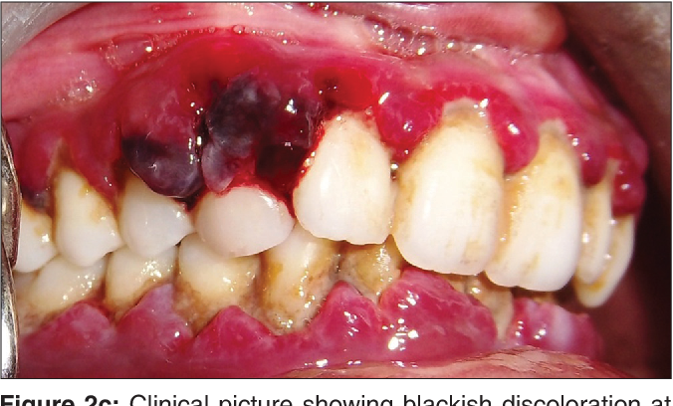
Scorbutic ginigivitis:
Gingivitis with enlarged, hemorrhagic, bluish-red gingiva is described as one of the classic signs of vitamin C deficiency.
Severe spontaneous bleeding of gums.
Acute vitamin C deficiency does not cause or increase the incidence of gingival inflammation, but it does increase its severity.
Vitamin C deficiency may aggravate the gingival response to plaque and worsen the edema, enlargement, and bleeding.

Slide 48
Periodontitis:
Acute vitamin C deficiency: results in
  edema and hemorrhage in the periodontal ligament,
  osteoporosis of the alveolar bone, and
  tooth mobility;
  hemorrhage, edema, and degeneration of the collagen fibers occur in the gingiva.
  impairs gingival healing.
The periodontal fibers that are least affected by vitamin C deficiency are those just below the junctional epithelium and above the alveolar crest, which explains the infrequent apical downgrowth of the ep.
Vitamin C deficiency alone does not cause periodontal destruction.
Local bacterial factors are required for increased probing depth and attachment loss to occur.
However, acute vitamin C deficiency accentuates the destructive effect of gingival inflammation on the underlying periodontal ligament and alveolar bone.

Slide 49
Protein deficiency
Hypoproteinemia→ muscular atrophy, weakness, weight loss, anemia, leukopenia, edema, impaired lactation, decreased resistance to infection, slow wound healing, lymphoid depletion, and reduced ability to form certain hormones and enzyme systems
protein-deprived animals:
  degeneration of the connective tissue of gingiva and the pdl,
  osteoporosis of the alveolar bone,
  impaired deposition of the cementum,
  delayed wound healing,
  atrophy of the tongue epithelium.
  Osteoporosis results from the reduced deposition of osteoid, a reduction in the number of osteoblasts, and impairment in the morphodifferentiation of connective tissue cells to form osteoblasts rather than from increased osteoclastic activity.
  periodontal tissues that lack integrity → vulnerable to breakdown when challenged by bacteria

Slide 50
STRESS AND PSYCHOSOMATIC DISORDERS
stress alone does not cause or lead to periodontitis in the absence of periodontal pathogens
impact periodontal health via changes in the individual’s:
  behavior and
  through complex interactions among the nervous, endocrine, and immune systems.

Slide 51
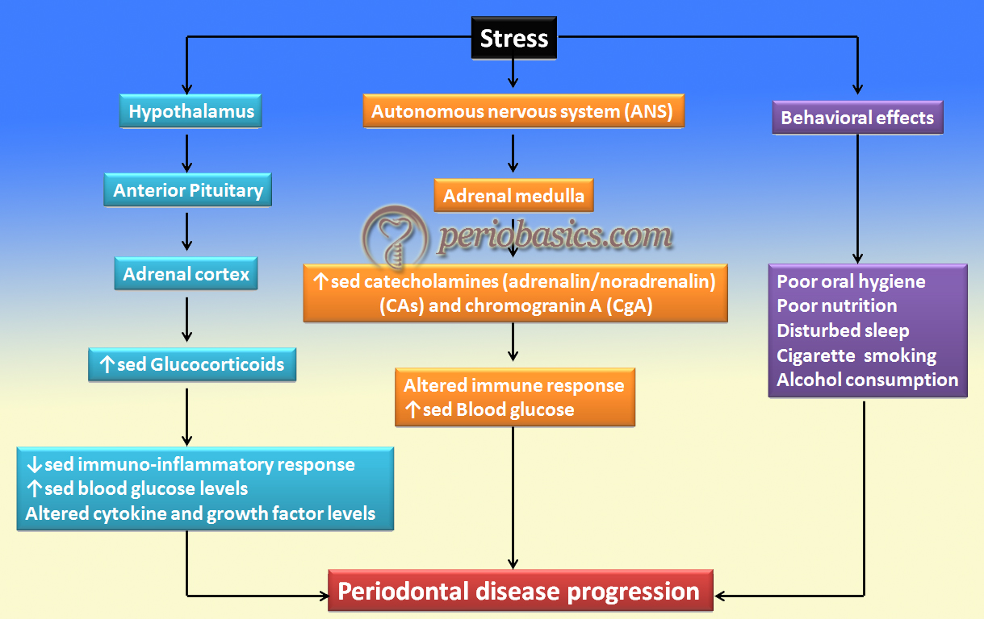

Slide 52
Influence of stress on periodontal therapy outcomes:
Depression might have a negative effect on periodontal treatment outcomes.
stress impairs the inflammatory response and matrix degradation.
Psychiatric influence of self-inflicted injury:
Neurotic habits such as grinding or clenching the teeth, nibbling on foreign objects (e.g., pencils, pipes), nail biting, and excessive use of tobacco are all potentially injurious to the teeth and the periodontium.
Self-inflicted gingival injuries, such as gingival recession, have been described in both children and adults.
However, these types of self-inflicted, factitious injuries do not appear to be common among psychiatric patients.

Slide 53
MEDICATIONS
Bisphosphonates:
  Used to treat cancer and osteoporosis
  Act by: inhibiting osteoclastic activity→ less bone resorption, remodeling and turnover.
  Bone-sparring or preserving action: hence used to prevent alveolar bone loss & for regeneration.
Corticosteroids:
  Systemically admnstrd cortisone & adrenocorticotropic hormone→ no effect on periodontal disease.
  Prednisone/methylprednisone used for immunosuppression→ less gingival inflammation than control subjects with similar amount of plaque

Slide 54
OTHER SYSTEMIC CONDITIONS
Osteoporosis:
characterized by low bone mass and structural deterioration leading to an increased risk of bone fracture
increase with age for both men and women, with women being affected earlier than men.
The rate of bone loss is greatest for women during the perimenopausal years, when estrogen levels decrease.
In patients with periodontal disease and concomitant postmenopausal osteoporosis, the possibility exists that the lack of estrogen influences the activities of bone cells and immune cells in such a way that the progression of alveolar bone loss is enhanced.
In fact, there are numerous studies that report less risk for tooth loss and improved oral health among postmenopausal women receiving hormone replacement therapy.

Slide 55
Congenital heart disease:
Characterized by defects in heart/ blood vessels/ both→ return of poorly oxygenated blood to systemic circulation→ chronic hypoxia→ polycythemia & incrsd risk of infective endocarditis due to turbulent blood flow
Findings:
  cyanosis of oral mucosa & lips
  Delayed teeth eruption
  Enamel hypoplasia
  Teeth→ bluish-white appearance with an increased pulp vascular volume.
  Severe caries & periodontitis (mostly related to poor oral hygiene)
Tetralogy of fallot: purplish-red discoloration of the lips and the gingiva. Severe marginal gingivitis and periodontal destruction have been reported.
Eisenmenger syndrome: Cyanosis of the lips, cheeks, and buccal mucous membranes is observed in these patients, but it is much less severe than in those with tetralogy of Fallot. Severe, generalized periodontitis has been reported

Slide 56
Hypophosphatasia:
rare familial skeletal disease that is characterized by rickets, poor cranial bone formation, craniostenosis, and the
premature loss of the primary teeth, particularly the incisors.
Teeth are lost with no clinical evidence of gingival inflammation, and they show reduced cementum formation.
In patients with minimal bone abnormalities, the premature loss of the deciduous teeth may be the only symptom of hypophosphatasia.
In adolescents, this disease resembles localized juvenile (aggressive) periodontitis

Slide 57
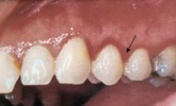
Metal intoxication:
Bismuth intoxication:
ulcerative gingivostomatitis, generally with pigmentation and accompanied by a metallic taste and burning sensation of the oral mucosa. The tongue may be sore and inflamed
Bismuth pigmentation: narrow, bluish-black discoloration of the gingival margin in areas of preexisting gingival inflammation
results from the precipitation of particles of bismuth sulfide associated with vascular changes in inflammation; it is not evidence of intoxication but simply indicates the presence of bismuth in the bloodstream.

Slide 58
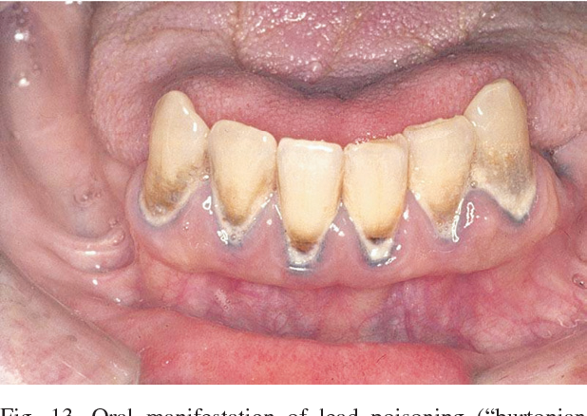
Lead intoxication
Lead is slowly absorbed, and toxic symptoms are not particularly definitive when they do occur.
There is a pallor of the face and lips and gastrointestinal symptoms that consist of nausea, vomiting, loss of appetite, and abdominal colic.
Peripheral neuritis, psychologic disorders, and encephalitis have been reported.
Oral signs include salivation, coated tongue, a peculiar sweetish taste, gingival pigmentation, and ulceration.
Gingival pigmentation is linear (Burtonian line), steel gray, and associated with local inflammation.
Oral signs may occur without toxic symptoms

Slide 59
Mercury intoxication
Mercury intoxication is characterized by headache, insomnia, cardiovascular symptoms, pronounced salivation (ptyalism), and a metallic taste.
Gingival pigmentation in linear form results from the deposition of mercuric sulfide.
The chemical also acts as an irritant, which accentuates the preexisting inflammation and often leads to notable ulceration of the gingiva and the adjacent mucosa as well as the destruction of the underlying bone.
Mercurial pigmentation of the gingiva also occurs in areas of local irritation in patients without symptoms of intoxication

Slide 60
Other chemicals
Other chemicals (e.g., phosphorus, arsenic, chromium) may cause necrosis of the alveolar bone, with loosening and exfoliation of the teeth.
Inflammation and ulceration of the gingiva are usually associated with the destruction of the underlying tissues.
Benzene intoxication is accompanied by gingival bleeding and ulceration with the destruction of the underlying bone

